Slide 1
Breadth First Search or BFS for a Graph
By Ram Lovewanshi

Slide 2
Breadth First Search (BFS) for a Graph:
Breadth First Search (BFS) is a graph traversal algorithm that explores all the vertices in a graph at the current depth before moving on to the vertices at the next depth level. It starts at a specified vertex and visits all its neighbors before moving on to the next level of neighbors. BFS is commonly used in algorithms for pathfinding, connected components, and shortest path problems in graphs.

Slide 3
Breadth First Search (BFS) for a Graph Algorithm:
The only catch here is, that, unlike trees, graphs may contain cycles, so we may come to the same node again. To avoid processing a node more than once, we divide the vertices into two categories:
Visited and
Not visited.
A boolean visited array is used to mark the visited vertices. For simplicity, it is assumed that all vertices are reachable from the starting vertex. BFS uses a queue data structure for traversal.

Slide 4
Breadth First Search (BFS) for a Graph Algorithm:
1. Initialization: Enqueue the starting node into a queue and mark it as visited.
2. Exploration: While the queue is not empty:
Dequeue a node from the queue and visit it (e.g., print its value).
For each unvisited neighbor of the dequeued node:
Enqueue the neighbor into the queue.
Mark the neighbor as visited.
3. Termination: Repeat step 2 until the queue is empty.
This algorithm ensures that all nodes in the graph are visited in a breadth-first manner, starting from the starting node.

Slide 5
How Does the BFS Algorithm Work?
Starting from the root, all the nodes at a particular level are visited first and then the nodes of the next level are traversed till all the nodes are visited.
To do this a queue is used. All the adjacent unvisited nodes of the current level are pushed into the queue and the nodes of the current level are marked visited and popped from the queue.

Slide 6
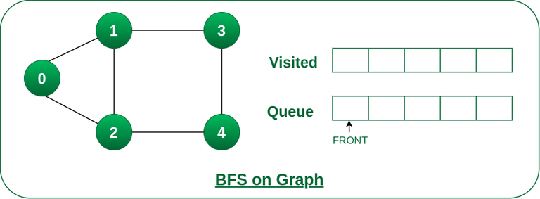
Step1: Initially queue and visited arrays are empty.
Queue and visited arrays are empty initially.

Slide 7
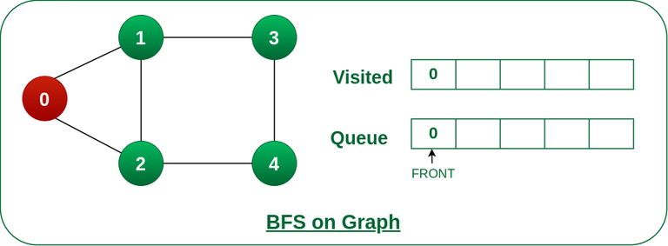
Step2: Push node 0 into queue and mark it visited.
Push node 0 into queue and mark it visited.

Slide 8
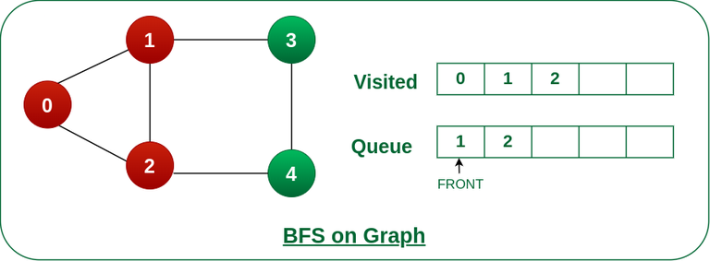
Step 3: Remove node 0 from the front of queue and visit the unvisited neighbours and push them into queue.
Remove node 0 from the front of queue and visited the unvisited neighbours and push into queue.

Slide 9
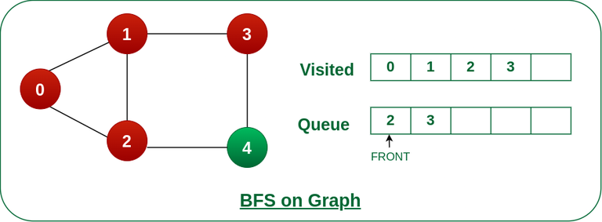
Step 4: Remove node 1 from the front of queue and visit the unvisited neighbours and push them into queue.
Remove node 1 from the front of queue and visited the unvisited neighbours and push

Slide 10
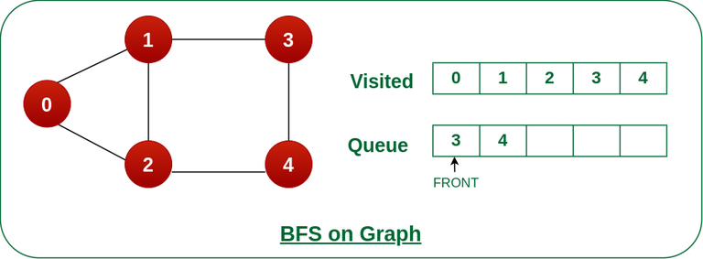
Step 5: Remove node 2 from the front of queue and visit the unvisited neighbours and push them into queue.
Remove node 2 from the front of queue and visit the unvisited neighbours and push them into queue.

Slide 11

Step 6: Remove node 3 from the front of queue and visit the unvisited neighbours and push them into queue.
As we can see that every neighbours of node 3 is visited, so move to the next node that are in the front of the queue.
Remove node 3 from the front of queue and visit the unvisited neighbours and push them into queue.

Slide 12

Steps 7: Remove node 4 from the front of queue and visit the unvisited neighbours and push them into queue.
As we can see that every neighbours of node 4 are visited, so move to the next node that is in the front of the queue.
Remove node 4 from the front of queue and visit the unvisited neighbours and push them into queue.

Slide 13
BFS
Now, Queue becomes empty, So, terminate these process of iteration.
Breadth First Traversal starting from vertex 0: 0 1 2 3 4
Time Complexity: O(V+E), where V is the number of nodes and E is the number of edges.

